Slide 1
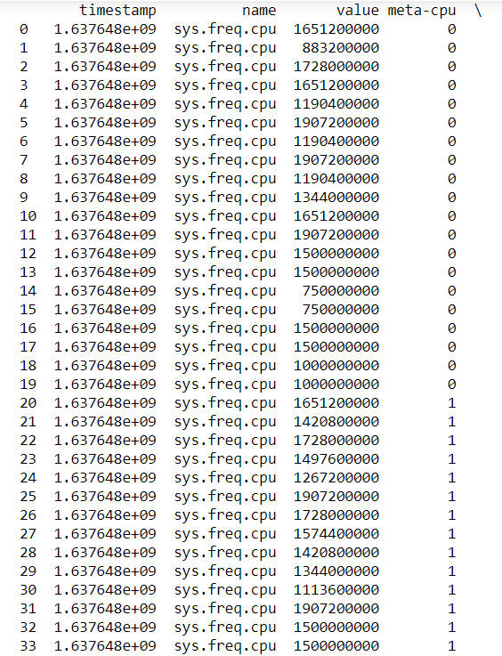
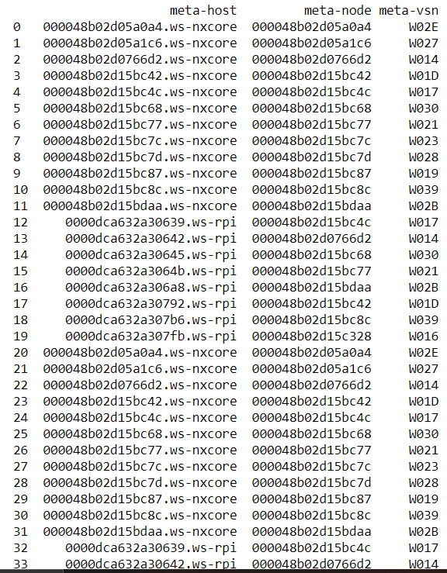
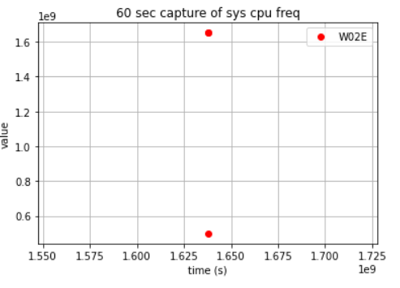
Experimented with turning json objects into pandas dataframes to graph them with matplotlib
This is just for one sensor node that I looked at as a sample.

Slide 2
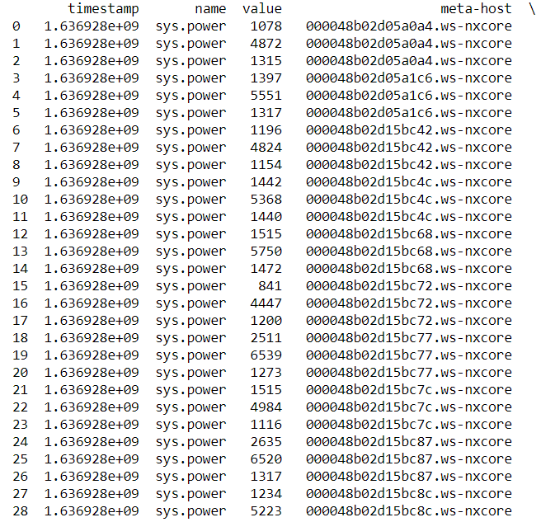
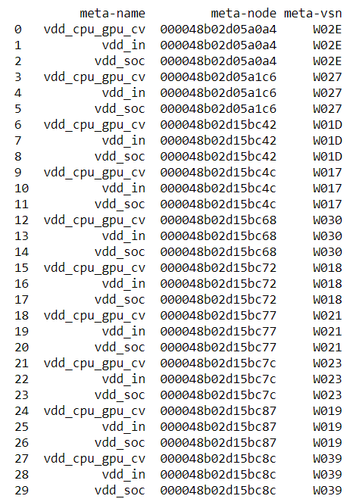
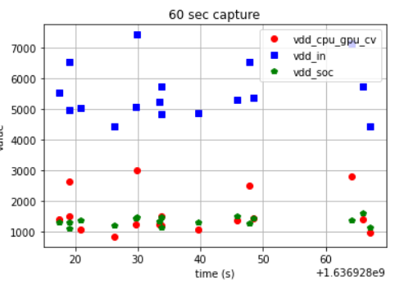
This is with sys.power, and this was a little confusing to look at

Slide 3
Additional questions
Finals are coming very soon for me, so I apologize once again if this week is lackluster. I need all the time I can get to finish these last couple of projects and it is also just very stressful for me right now because of a family emergency going on.
Would you be okay with me focusing on this project during my winter break? I can still provide updates and such.

